Slide 1
Some housekeeping
Everyone have R and RStudio ready to go?
Download Seminar Repo: github.com/erramirez/r4bs
No question is a “dumb question”
You are going to fail, and that’s how you learn
Meet your neighbor:
What scares you about learning R?
What is your long-term goal as an R user?

Slide 2
R for Behavioral Science
Ernesto Ramirez, PhD, MS
Gina Merchant, PhD, MA

Slide 3
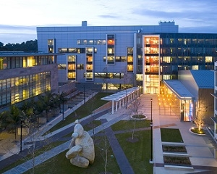
About us
Ernesto @eramirez
Fitabase
Director of Research & Development
Gina @drgmerchant
ResMed
Behavioral Science Strategist for Patient Engagement
Notes:
Friends since 2010, when we were both SPSS users (I was still point and click & Ernesto was writing syntax)
GM: R user since 2013. Text as data & engagement data.
ER: R user since. Sensor data & data visualization.

Slide 4
Outline
Getting started with R 8:45 – 9
Reading in data 9 – 9:30
EXERCISE 1: Reading in multiple files and formatting variables
BREAK
Data manipulation 9:45 – 10:30
EXERCISE 2: Data cleaning and deriving data
Visualization 10:30 – 11
EXERCISE 3: Visualize time series data
The R community and resources 11:15 – 11:30

Slide 5
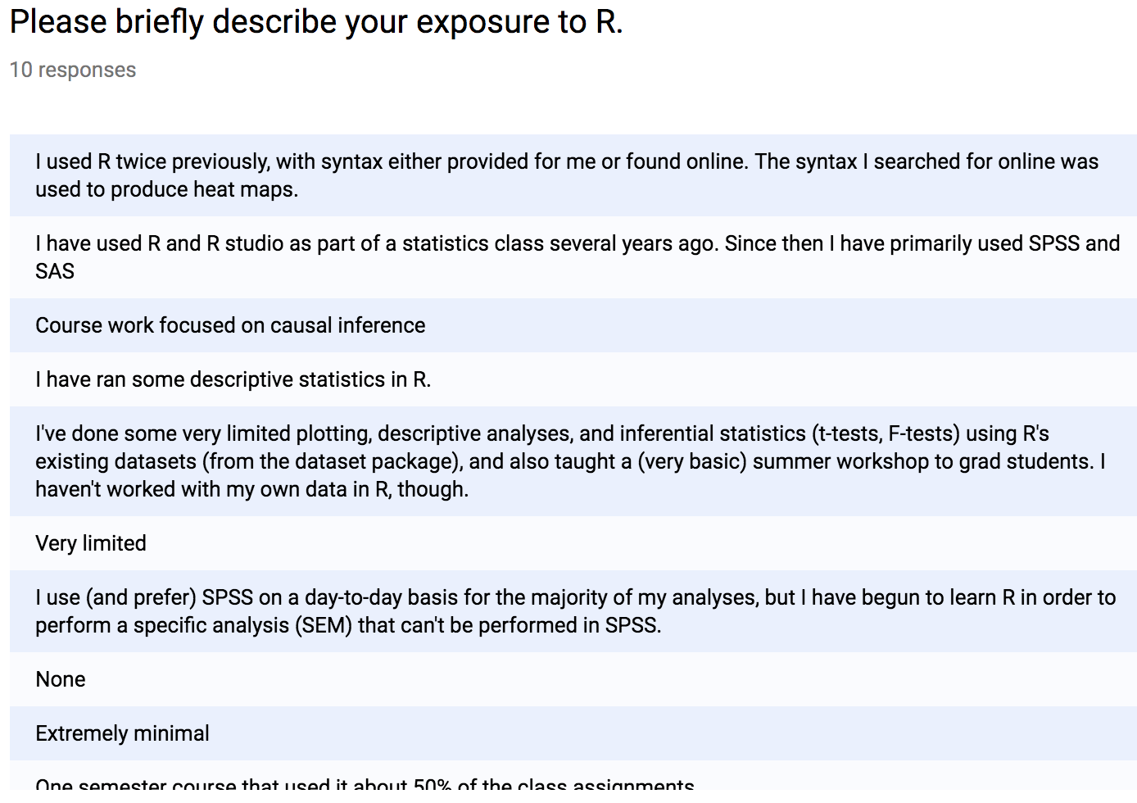
Notes:
Have people with no exposure sit next to someone with some exposure…

Slide 6
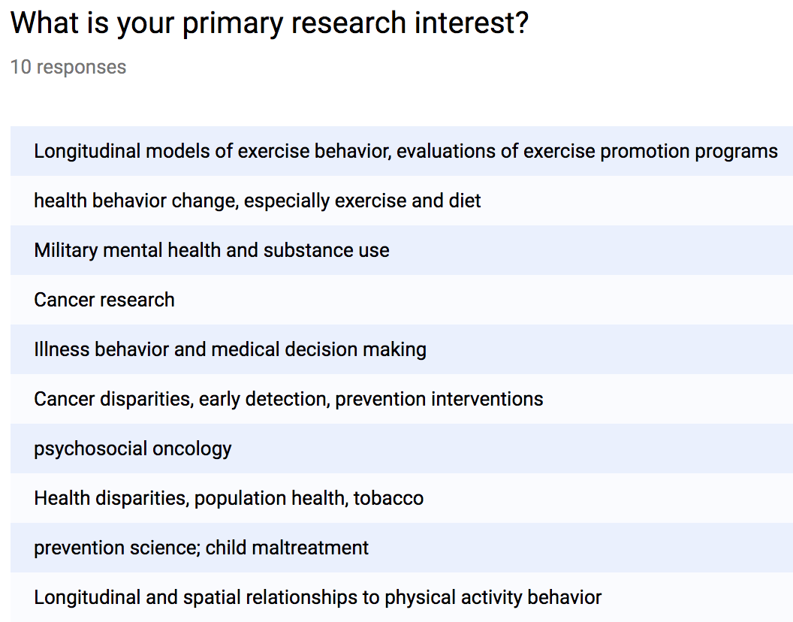

Slide 7
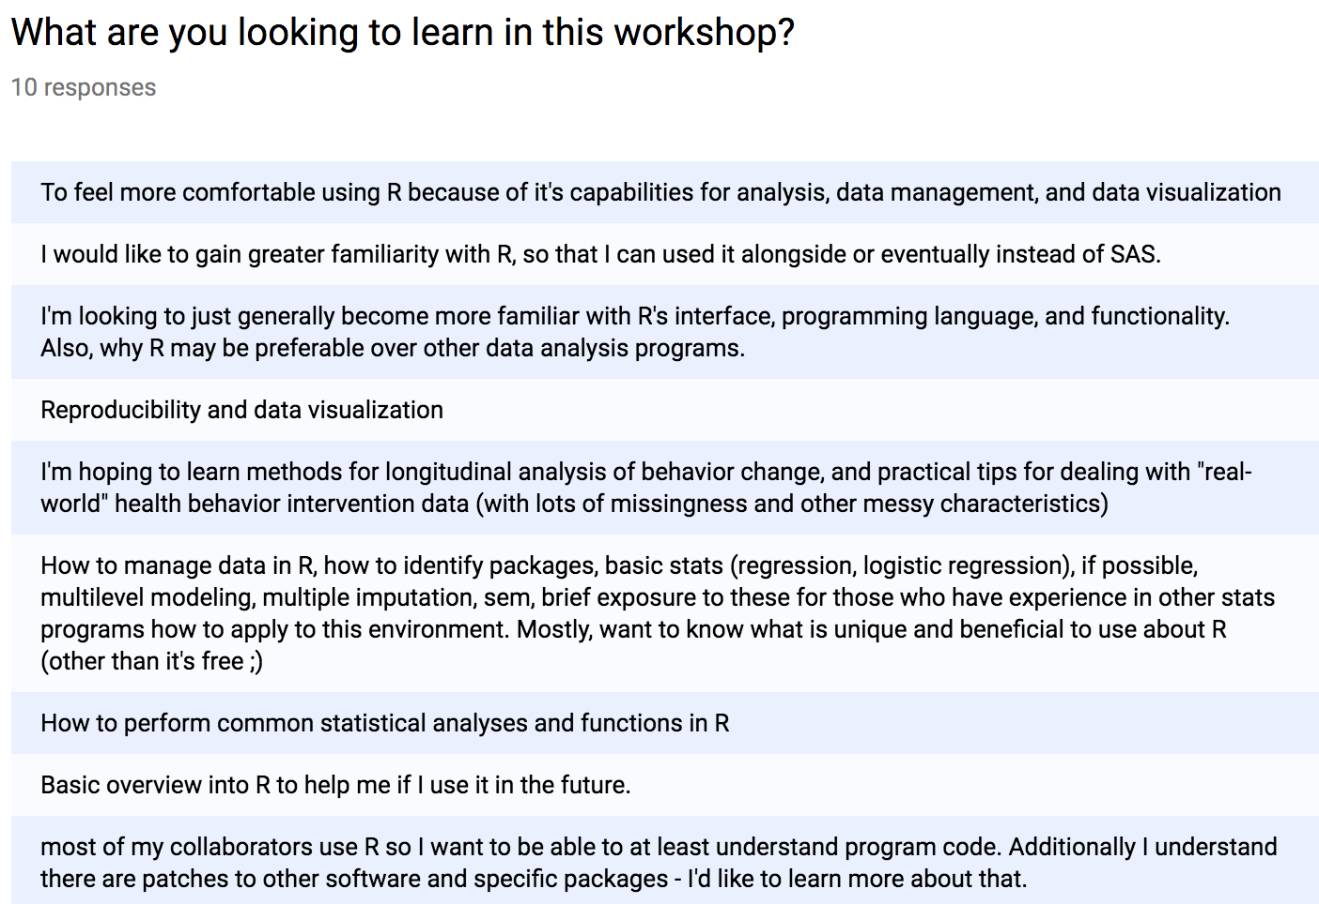
Notes:
What this workshop is (intro)
What it isn’t (methods/stats)

Slide 8
Getting started with R
8:45 – 9 am

Slide 9
About R
1993
S language
Object-oriented language
Free!
Open source w/frequent releases & updates
Contributors from around the world
Active & supportive user community
Notes:
4K packages
Uploaded to CRAN

Slide 10
The aim of the language, is "to turn ideas into software, quickly and faithfully".
- John Chambers

Slide 11
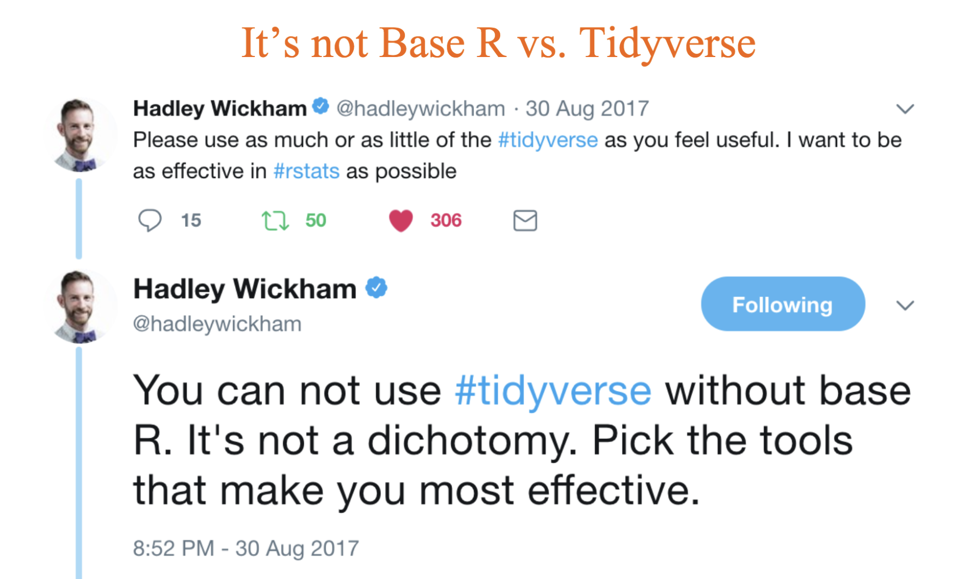
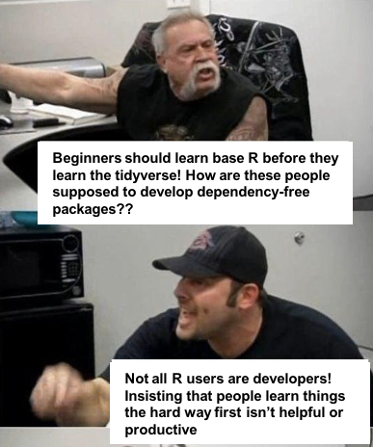

Slide 12
RStudio
Interactive:
Script
Console
Environment
Help & documentation

Slide 13
R Basics
Your working directory getwd() setwd()
Packages install.packages() library()
tidyverse
Tibbles
Piping %>%

Slide 14
R Basics
Creating an object
fruit <- c(“Apple”, “Orange”, ”Pineapple”)
fruit = c(“Apple”, “Orange”, ”Pineapple”)
Functions & arguments
FV = merge(fruit, veg, by = "ID", all.x = T)
Vectors, Dataframes, lists, oh my!
Notes:
Check that Rproject is open and start practice script

Slide 15
Reading in data
9 – 9:30 am

Slide 16
Reading in data
Question:
How do you want your data?
Answer:
Raw
As a .csv file
read.csv() str() names()
head() tail()

Slide 17
Formatting data
readr package read_csv()
Specifying column types col_type
Working with dates in R
Working with factors:
is.factor()
is.ordered()
pts.dys2$time_grp = factor(pts.dys2$time_grp,
levels = c("First", "Middle", "Last"), ordered = T)

Slide 18
** BREAK ** 9:30 – 9:45 am

Slide 19
Data manipulation
9:45 – 10:30 am

Slide 20
What the heck is “tidy” data?
Tidy data is defined as:
Each var having its own column
Each observation having its own row
Each value having its own cell
Wide vs. long datasets
Key-value pairs
Piping %>%

Slide 21
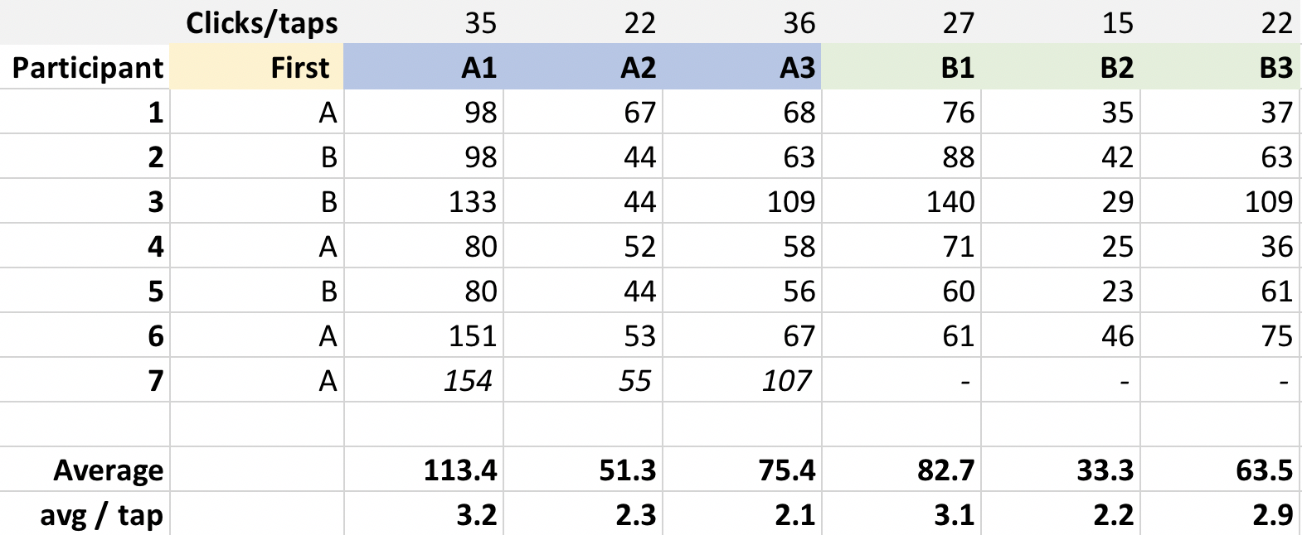

Slide 22
Tidying your data
Transforming
gather() vs. spread()
Merging
Base: rbind() cbind()
dplyr: bind_rows() bind_cols()
dplyr: joins…

Slide 23
Data manipulation
Deriving vars
mutate()
Aggregating
group_by()
summarise()
Base: ifelse()
dplyr: case_when()

Slide 24
Data manipulation
Intermediate steps that don’t create something per se
filter()
select()

Slide 25
Visualization
10:30 – 11 am

Slide 26
The power of ggplot2
Make your base plot using ggplot()
Add layers to your plot using geom_point() for example
Points
Lines
Bars

Slide 27
Making plots functional
Useful functions & arguments:
facet_grid()
fill =
colour =
Formatting examples
theme_grey()
colour_discrete()
labs()
theme()
Saving plots using ggsave()

Slide 28
The R community & resources
11:15 – 11:30 am

Slide 29
google

Slide 30
People
R Ladies
R Forwards
Jenny Bryan
Hadley Wickham
David Robinson
Julia Silge
Emily Robinson

Slide 31
Places
Twitter
Facebook
Conferences
RStudio
Datacamp

Slide 32
Things
R bloggers RSS feed
R for Data Science
R for SAS & SPSS Users
Rstudio Cheatsheets
Stackoverflow
Quick-R
R for Dummies

Slide 33
Thank you!
gina.merchant@resmed.com
ernesto@fitabase.com

